Slide 1
Basics of React

Slide 2
Basics of React
Obstacles and roadblocks
React’s future
Keeping up with the changes
Working with files

Slide 3
Functional Programming with Javascript
Declaring variables in es6
Arrow functions
Transpiling es6
Es6 objects and arrays
Promises classes
Es6 modules
Commonjs
What it means to be functional
Imperative versus declarative
Functional concepts

Slide 4
React JS
Front-end library by FB, not framework
View part of mobile or web Apps.
Reusable UI components
Popular JS library
Good support and community
Open source and component based responsible for view part

Slide 5
Prerequisites
JavaScript()
HTML5
CSS
ECMAScript 2015(European Computer Manufacturer's Association)

Slide 6
Why React JS
Improves speed of app
Uses Virtual DOM- improved performance
Faster than DOM
Can used in both client and server side as well with some other frameworks
Readability –due to components
Maintains longer code

Slide 7
ES6 Classes
JavaScript classes, introduced in ECMA script 2015, are primarily syntactical sugar over javascripts existing prototype-based inheritance
The class syntax does not introduce a new object-oriented inheritance model to javascript
Classes are in fact “special functions”, and just as you can define function expressions and function declarations
Class syntax has two components
Class expressions
Class declarations

Slide 8
Class Declarations
One way to define a class is using a class declaration. To declare a class, you use the class keyword
Class Rectangle
{
Constructor(height,width)
{
This.height=height;
This.width=width;
}
}

Slide 9
Hoisting 1
Hoisting is JavaScript default behavior of moving declarations to the top.
In javaScript, a variable can be declared after it has been used.
In other words, a variable can be used before it has been declared.
Var x;
X=5;
Console.log(x); //55
x=5;
Var x;
Console.log(x); //5
fName=“kumar”
lName=“Arun”
Var fname, lName
Console.log(fName,lName); //kumar Arun
Var fname, lName
fName=“kumar”
lName=“Arun”
Console.log(fName,lName); //kumar Arun

Slide 10
Hoisting 2
Variables and constants declared with let or const are not hoisted
x=5;
let x;
Console.log(x);
//ReferenceError: Cannot access ‘x’ before initialization
x=5;
const x;
Console.log(x);
// SyntaxError: Missiong initializer in const declaration

Slide 11
Hoisting 3
Javascript only hoists declarations, not initializations.
Only the declaration (var y), not the initialization(=7) is hoisted to the top
Var x=5; // Initialize x
Var y=5; // Initialize y
Console.log(x +y); //12
Var x=5; // Initialize x
Console.log(x +y); //Nan
Var y=7; // Initialize y

Slide 12
ReactJS - Architecture
React library is built on a solid foundation.
It is simple, flexible and extensible. React is a library to create user interface in a web application.
React’s primary purpose is to enable the developer to create user interface using pure JavaScript.
Normally, every user interface library introduces a new template language (which we need to learn) to design the user interface and provides an option to write logic, either inside the template or separately.
Instead of introducing new template language, React introduces three simple concepts as given below −

Slide 13
Cont…
React elements
JavaScript representation of HTML DOM. React provides an API, React.createElement to create React Element.
JSX
A JavaScript extension to design user interface. JSX is an XML based, extensible language supporting HTML syntax with little modification. JSX can be compiled to React Elements and used to create user interface.
React component
React component is the primary building block of the React application.
It uses React elements and JSX to design its user interface.
React component is basically a JavaScript class (extends the React.component class) or pure JavaScript function.
React component has properties, state management, life cycle and event handler. React component can be able to do simple as well as advanced logic.

Slide 14
React.createElement
Used to create React elements. It expects three parameters −
Element tag
Element attributes as object
Element content - It can contain nested React element as well
ReactDOM.render
Used to render the element into the container. It expects two parameters −
React Element OR JSX
Root element of the webpage

Slide 15
Nested React element
As React.createElement allows nested React element, let us add nested element as shown below −
Example
<script language="JavaScript"> element = React.createElement('div', {}, React.createElement('h1', {}, 'Hello React!')); ReactDOM.render(element, document.getElementById('react-app')); </script>

Slide 16
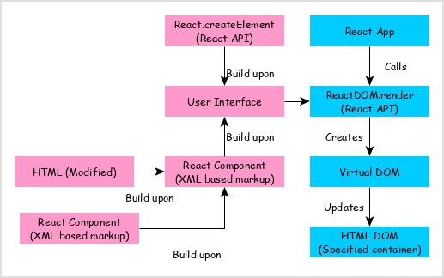
Visualize the workflow of the React application
React app calls ReactDOM.render method by passing the user interface created using React component (coded in either JSX or React element format) and the container to render the user interface.
ReactDOM.render processes the JSX or React element and emits Virtual DOM.
Virtual DOM will be merged and rendered into the container.

Slide 17
Architecture of the React Application
React library is just UI library and it does not enforce any particular pattern to write a complex application.
Developers are free to choose the design pattern of their choice. React community advocates certain design pattern.
One of the patterns is Flux pattern. React library also provides lot of concepts like Higher Order component, Context, Render props, Refs etc., to write better code.
React Hooks is evolving concept to do state management in big projects. Let us try to understand the high level architecture of a React application.

Slide 18
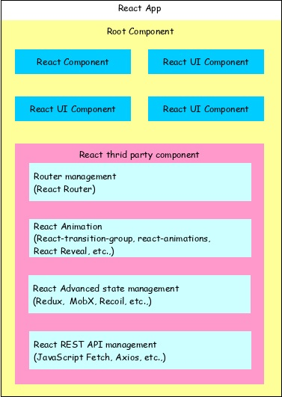
Cont…
React app starts with a single root component.
Root component is build using one or more component.
Each component can be nested with other component to any level.
Composition is one of the core concepts of React library. So, each component is build by composing smaller components instead of inheriting one component from another component.
Most of the components are user interface components.
React app can include third party component for specific purpose such as routing, animation, state management, etc.

Slide 19
Javascript ES6 Arrow functions
Arrow functions allow us to write shorter function syntax:
Arrow Functions Return Value by Default:
hello = function() {
return "Hello World!";
}
hello = ()=> {
return "Hello World!";
}

Slide 20
Cont…
Using an arrow function in render creates a new function each time the component renders, which may break optimizations based on strict identity comparison.
Difference between regular functions and arrow functions
An arrow function expression is a syntactically compact alternative to a regular function expression, although without its own bindings to the this, arguments, super, or new. target keywords. Arrow function expressions are ill suited as methods, and they cannot be used as constructors.

Slide 21
There are 3 subtle differences in regular functions and arrow functions
Arrow functions do not have their own this value. The value of this inside an arrow function is always inherited from the enclosing scope.
Example
this.a = 100;
let arrowFunc = () => {this.a = 150};
function regFunc() {
this.a = 200;
}
console.log(this.a)
arrowFunc()
console.log(this.a)
regFunc()
console.log(this.a)
Output: 100
150
200

Slide 22
Arrow functions do not have a arguments array
Arguments array in functions is a special object that can be used to get all the arguments passed to the function.
Similar to this, arrow functions do not have their own binding to a arguments object, they are bound to arguments of enclosing scope.

Slide 23
Arrow functions are callable but not constructable
If a function is constructable, it can be called with new, i.e. new User(). If a function is callable, it can be called without new (i.e. normal function call).
Functions created through function declarations / expressions are both constructable and callable.
Arrow functions (and methods) are only callable. class constructors are only constructable.
If you are trying to call a non-callable function or to construct a non-constructable function, you will get a runtime error.

Slide 24
Example
let arrowFunc = () => {}
new arrowFunc()
This code gives the error:
arrowFunc is not a constructor

Slide 25
Cont…
The handling of this is also different in arrow functions compared to regular functions.
In short, with arrow functions there are no binding of this.
In regular functions the this keyword represented the object that called the function, which could be the window, the document, a button or whatever.
With arrow functions, the this keyword always represents the object that defined the arrow function.

Slide 26
Transpiling ES6 modules to ES5 using Babel BabelJS - ES6 Code Execution
ECMAScript 2015 (also known as ES 2015 or ES6) is the current version of JavaScript, and its biggest update till date.
BabelJS is a JavaScript transpiler, which converts new features added to JavaScript into ES5 or to react based on the preset or plugin given.
ES5 is one of the oldest form of JavaScript and is supported to run on new and old browsers without any issues.
We have seen many features like arrow functions, classes, promises, generators, async functions, etc.

Slide 27
Cont…
Added to ES6, ES7 and ES8. When any of the newly added features are used in old browsers, it throws errors.
It comes with a number of language improvements and API updates to make JavaScript developers more productive. The specification of the language was frozen in June 2015.
Browsers have started implementing the new features, although they still need some time to implement all the features.

Slide 28
Cont…
belJS helps in compiling the code, which is backward compatible with older browsers.
We have seen that ES5 works perfectly fine on older browsers without any issues.
So considering the project environment details, if it is required to be running on older browsers.
we can use any new feature in our project and compile the code to ES5 using babeljs, and use it any browsers without any issues.

Slide 29
Example
<html>
<head>
<title>BabelJs Testing</title>
</head>
<body>
<script type="text/javascript" src="index.js"></script>
</body>
</html>

Slide 30
Index.js
var _foo = () => {
return "Hello World"
};
alert(_foo());

Slide 31
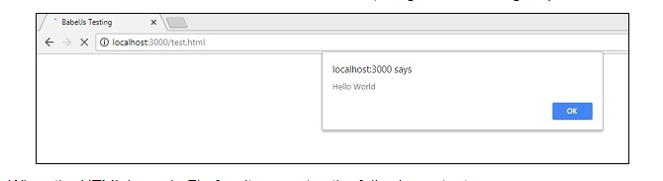
Output
When we run the above html in the Chrome browser, we get the following output −

Slide 32
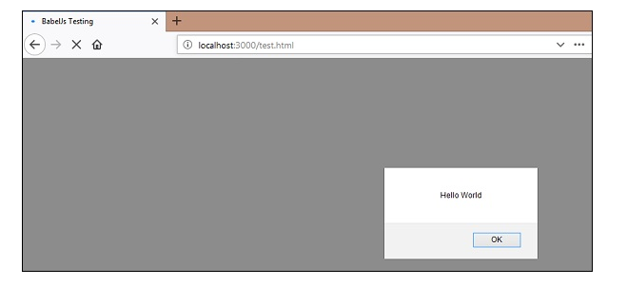
When the HTML is run in Firefox, it generates the following output −

Slide 33
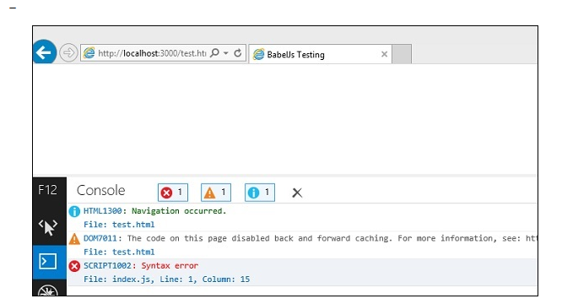
And when the same HTML is run in Internet Explorer, it generates the following syntax error

Slide 34
Set Up Babel
Type the following command to install the babel-cli and babel-core modules:
npm install babel-cli babel-core --save-dev
There are different ways to install and run Babel. For example, you could also install Babel globally and run it from the command line.
Type the following command to install the ECMAScript 2015 preset:
npm install babel-preset-es2015 --save-dev
In Babel 6, every transformer is a plugin that can be installed separately. A preset is a group of related plugins.

Slide 35
Cont
Install http-server in your project. http-server is a lightweight web server we use to run the application locally during development.
npm install http-server --save-dev
Build and Run
On the command line, make sure you are in the es6 Current directory, and type the following command to run the babel script and compile main.js:
npm run babel

Slide 36
Cont…
Open index.html in your code editor, and modify the <script> tag as follows to load build/main.bundle.js, the compiled version of js/main.js:
<script src="build/main.bundle.js"></script>
Open a new command prompt. Navigate (cd) to the es6-tutorial directory, and type the following command to start http-server:
npm start

Slide 37
Cont…
If port 3030 is already in use on your computer, modify the start script in package.json and specify a port that is available on your computer. For example:
"scripts": {
"babel": "babel --presets es2015 js/main.js -o build/main.bundle.js",
"start": "http-server -p 9000"
},
Open a browser and access http://localhost:3030

Slide 38
How to Use Variables within Classes
Variables store data in terms of values that may or may not be modified into the current context.
They can be declared using the various data types available depending on the programming or scripting language.
Here, how to declare and work with various types of variables within classes, including the this keyword, static, props, and state variables.

Slide 39
Using the This Keyword
The scope of a variable may be different based on the situation.
The this keyword typically references a JavaScript element depending on the different scope or context where it’s being used.
For example, if you console the keyword this into the global scope, then you will be able to get the empty object.
console.log(this);
But if you want to use inbuilt JavaScript functionalities or browser-based functionalities, then the window object can be used.
window.alert("this is test alert")

Slide 40
The same applies to a function using the global scope.
const thisFunction = function () {
return "Hello World";
}
let msg = thisFunction()
console.log(msg)

Slide 41
Cont….
In React component classes, the methods that will refer to class attributes, such as props and state, can be defined into the current context.
For the methods of the components, you have access to this.state and this.props, and you need to bind the React component for this context to those methods.

Slide 42
For Example
import React, { Component } from "react";
import { render } from "react-dom";
class App extends Component {
constructor() {
super();
this.state = {
name: "React",
};
// Binding method
this.onFormSubmit = this.onFormSubmit.bind(this);
}
onFormSubmit() {
console.log("Form Submitted");
}
render() {
return (
<div>
<div>
<form>
<input type="text" />
<button onClick={this.onFormSubmit}>Submit</button>
</form>
</div>
</div>
);
}
}
render(<App />, document.getElementById("root"));

Slide 43
Cont…
Try to access any props after binding, use the props value as given in the example below.
onFormSubmit() {
console.log(this.props.formValues);
}

Slide 44
Using Static as the Variable Type
Static variables can be used within React classes, just like other different kinds of variables can access it.
The difference is that the scope of the variables can be modified for static variables, and it cannot be modified.
class App extends Component {
// Declaring static variable
static num1 = 3.1416;
constructor() {
super();
}
render() {
return (
<div>
<div>Accessing local static number variable : {this.num1}</div>
</div>
);}} render(<App />, document.getElementById("root"));

Slide 45
The state object will be static, and this means we can pass it to the child component and it will act as a constant value.
class App extends Component {
state = {
name: 'Hello World',
age: '30'
};
render() {
const { name, age } = this.state;
console.log(this.state)
return (
<div>
</div>
);}}render(<App />, document.getElementById("root"));

Slide 46
Using State Variables
State is one of the widely used terms in React.
It is used to manage the component-based data transmission where you can declare the key-value pair and modify it based on the functional requirements.
The state can be declared into the constructor or as a static object.

Slide 47
React State
The state is an updatable structure that is used to contain data or information about the component.
The state in a component can change over time.
The change in state over time can happen as a response to user action or system event.
A component with the state is known as stateful components. It is the heart of the react component which determines the behavior of the component and how it will render.
They are also responsible for making a component dynamic and interactive.

Slide 48
Cont…
A state must be kept as simple as possible.
It can be set by using the setState() method and calling setState() method triggers UI updates.
A state represents the component's local state or information.
It can only be accessed or modified inside the component or by the component directly.
To set an initial state before any interaction occurs, we need to use the getInitialState() method.
For example, if we have five components that need data or information from the state, then we need to create one container component that will keep the state for all of them.

Slide 49
For example.
constructor() {
super();
this.state = {
name: "React",
students: [
{
id: 123,
name: "Student 1"
},
{
id: 456,
name: "Student 2"
},
{
id: 789,
name: "Student 3"
}]}; }
render() {
// Using state value
const { students } = this.state;
return (
<div>
// using state value for rendering
</div>
);
}

Slide 50
Defining State
To define a state, you have to first declare a default set of values for defining the component's initial state.
To do this, add a class constructor which assigns an initial state using this.state.
The 'this.state' property can be rendered inside render() method.
Example program
?

Slide 51
Changing the State
We can change the component state by using the setState() method and passing a new state object as the argument.
Now, create a new method toggleDisplayBio() in the above example and bind this keyword to the toggleDisplayBio() method.
otherwise we can't access this inside toggleDisplayBio() method.
this.toggleDisplayBio = this.toggleDisplayBio.bind(this);

Slide 52
Example
In this example, we are going to add a button to the render() method. Clicking on this button triggers the toggleDisplayBio() method which displays the desired output.
import React, { Component } from 'react’;
Program

Slide 53
Components and Props
Components let you split the UI into independent, reusable pieces, and think about each piece in isolation.
components are like JavaScript functions. They accept arbitrary inputs (called “props”) and return React elements describing what should appear on the screen.

Slide 54
Function and Class Components
The simplest way to define a component is to write a JavaScript function:
This function is a valid React component because it accepts a single “props” (which stands for properties) object argument with data and returns a React element.
We call such components “function components” because they are literally JavaScript functions.
function Welcome(props) {
return <h1>Hello, {props.name}</h1>;
}

Slide 55
An ES class to define a component:
class Welcome extends React.Component {
render() {
return <h1>Hello, {this.props.name}</h1>;
}
}

Slide 56
Rendering a Component
Previously, we only encountered React elements that represent DOM tags:
However, elements can also represent user-defined components:
const element = <div />;
const element = <Welcome name="Sara" />;

Slide 57
Cont…
This code renders “Hello, Sara” on the page:
We call ReactDOM.render() with the <Welcome name="Sara" /> element.
React calls the Welcome component with {name: 'Sara'} as the props.
Our Welcome component returns a <h1>Hello, Sara</h1> element as the result.
React DOM efficiently updates the DOM to match <h1>Hello, Sara</h1>.
function Welcome(props) {
return <h1>Hello, {props.name}</h1>;
}
const element = <Welcome name="Sara" />;
ReactDOM.render(
element,
document.getElementById('root')
);

Slide 58
How do I render a different component in React?
In React content rendered by a component can contain other components also, this features allow us to create more complex applications.
Create React App
Type the following command to create a new react app:
npx create-react-app demo
Now, go to the project folder:
cd demo
Create new Header component and type out the below code into Header.js

Slide 59
Header.JS
src\components\Header.js
import React, { Component } from 'react';
class Header extends Component {
render() {
return (
<div>
This is header component.
</div>
);
}
}
export default Header;

Slide 60
Footer.JS
Create new Footer component and type out the below code into Footer.js
import React, { Component } from 'react';
class Footer extends Component {
render() {
return (
<div>
This is Footer component.
</div>
);
}
}
export default Footer;

Slide 61
Composing Components
Components can refer to other components in their output. This lets us use the same component abstraction for any level of detail.
A button, a form, a dialog, a screen: in React apps, all those are commonly expressed as components.
For example, we can create an App component that renders Welcome many times:
function Welcome(props) {
return <h1>Hello, {props.name}</h1>;
} function App() {
return (
<div> <Welcome name="Sara" /> <Welcome name="Cahal" /> <Welcome name="Edite" />
</div>
); }
ReactDOM.render(
<App />,
document.getElementById('root')
);

Slide 62
update default App.js with below code snippet
import React, { Component } from 'react';
import Header from './components/Header';
import Footer from './components/Footer';
class App extends Component {
render() {
return (
<div>
<Header />
<Footer />
</div>
);
}
}
export default App;
src\App.js

Slide 63
React State Example
State is the place where the data comes from.
We should always try to make our state as simple as possible and minimize the number of stateful components. If we have, for example, ten components that need data from the state, we should create one container component that will keep the state for all of them.
State is basically like a global object that is available everywhere in a component.
Example of a Stateful Class Component:
Example code

Slide 64
React State VS Props Example
When we start working with React components, we frequently hear two terms. They are state and props. So, in this article we will explore what are those and how they differ.
State:
State is something that a component owns. It belongs to that particular component where it is defined. For example, a person’s age is a state of that person.
State is mutable. But it can be changed only by that component that owns it. As I only can change my age, not anyone else.
You can change a state by using this.setState()
Example code (person.js)

Slide 65
Props:
Props are similar to method arguments. They are passed to a component where that component is used.
Props is immutable. They are read-only.
Example code for props

Slide 66
ReactJS - JSX
React JSX is an extension to JavaScript.
It enables developer to create virtual DOM using XML syntax.
What is DOM vs virtual DOM?
The Document Object Model (DOM) is an application programming interface (API) for HTML and XML documents. It defines the logical structure of documents and the way a document is accessed and manipulated.
In React, for every DOM object, there is a corresponding “virtual DOM object.” A virtual DOM object is a representation of a DOM object, like a lightweight copy. A virtual DOM object has the same properties as a real DOM object, but it lacks the real thing's power to directly change what's on the screen.
It compiles down to pure JavaScript (React.createElement function calls).
Since it compiles to JavaScript, it can be used inside any valid JavaScript code.
For example, below codes are perfectly valid.

Slide 67
Cont…
Assign to a variable
Assign to a variable based on a condition.
Can be used as return value of a function.
var greeting = <h1>Hello React!</h1>
var canGreet = true;
if(canGreet) {
greeting = <h1>Hello React!</h1>
}
function Greeting() {
return <h1>Hello React!</h1>
}
greeting = Greeting()

Slide 68
Cont…
Can be used as argument of a function.
function Greet(message) {
ReactDOM.render(message, document.getElementById('react-app')
}
Greet(<h1>Hello React!</h1>)

Slide 69
Expressions
JSX supports expression in pure JavaScript syntax.
Expression has to be enclosed inside the curly braces, { }. Expression can contain all variables available in the context, where the JSX is defined.
Let us create simple JSX with expression.
Example
<script type="text/babel">
var cTime = new Date().toTimeString();
ReactDOM.render(
<div><p>The current time is {cTime}</p></div>,
document.getElementById('react-app') );
</script>

Slide 70
Output
Here, cTime used in the JSX using expression. The output of the above code is as follows,
The Current time is 21:19:56 GMT+0530(India Standard Time)

Slide 71
Functions
JSX supports user defined JavaScript function.
Function usage is similar to expression. Let us create a simple function and use it inside JSX.
Example
<script type="text/babel">
var cTime = new Date().toTimeString();
ReactDOM.render(
<div><p>The current time is {cTime}</p></div>,
document.getElementById('react-app')
);
</script>

Slide 72
Output
getCurrentTime() is used get the current time and the output is similar as specified below −
The Current time is 21:19:56 GMT+0530(India Standard Time)

Slide 73
Attributes
JSX supports HTML like attributes.
All HTML tags and its attributes are supported.
Attributes has to be specified using camelCase convention (and it follows JavaScript DOM API) instead of normal HTML attribute name.
For example, class attribute in HTML has to be defined as className.
The following are few other examples −
htmlFor instead of for
tabIndex instead of tabindex
onClick instead of onclick

Slide 74
Example Program
<style>
.red { color: red }
</style>
<script type="text/babel">
function getCurrentTime() {
return new Date().toTimeString();
}
ReactDOM.render(
<div>
<p>The current time is <span className="red">{getCurrentTime()}</span></p>
</div>,
document.getElementById('react-app')
);
</script>

Slide 75
Output
The output is as follows −
The Current time is 22:36:55 GMT+0530(India Standard Time)

Slide 76
ReactJS - Props Validation
Properties validation is a useful way to force the correct usage of the components.
This will help during development to avoid future bugs and problems, once the app becomes larger.
It also makes the code more readable, since we can see how each component should be used.

Slide 77
Validating Props
In this example, we are creating App component with all the props that we need.
App.propTypes is used for props validation.
If some of the props aren't using the correct type that we assigned, we will get a console warning.
After we specify validation patterns, we will set App.defaultProps.

Slide 78
React Props validation example output
?

Slide 79
App.jsx
import React from 'react';
class App extends React.Component {
render() {
return (
<div>
<h3>Array: {this.props.propArray}</h3>
<h3>Bool: {this.props.propBool ? "True..." : "False..."}</h3>
<h3>Func: {this.props.propFunc(3)}</h3>
<h3>Number: {this.props.propNumber}</h3>
<h3>String: {this.props.propString}</h3>
<h3>Object: {this.props.propObject.objectName1}</h3>
<h3>Object: {this.props.propObject.objectName2}</h3>
<h3>Object: {this.props.propObject.objectName3}</h3>
</div>
);
}
}
App.propTypes = {
propArray: React.PropTypes.array.isRequired,
propBool: React.PropTypes.bool.isRequired,
propFunc: React.PropTypes.func,
propNumber: React.PropTypes.number,
propString: React.PropTypes.string,
propObject: React.PropTypes.object
}

Slide 80
App.defaultProps = {
propArray: [1,2,3,4,5],
propBool: true,
propFunc: function(e){return e},
propNumber: 1,
propString: "String value...",
propObject: {
objectName1:"objectValue1",
objectName2: "objectValue2",
objectName3: "objectValue3"
}
}
export default App;
Main.js
import React from 'react';
import ReactDOM from 'react-dom';
import App from './App.jsx';
ReactDOM.render(<App/>, document.getElementById('app'));

Slide 81
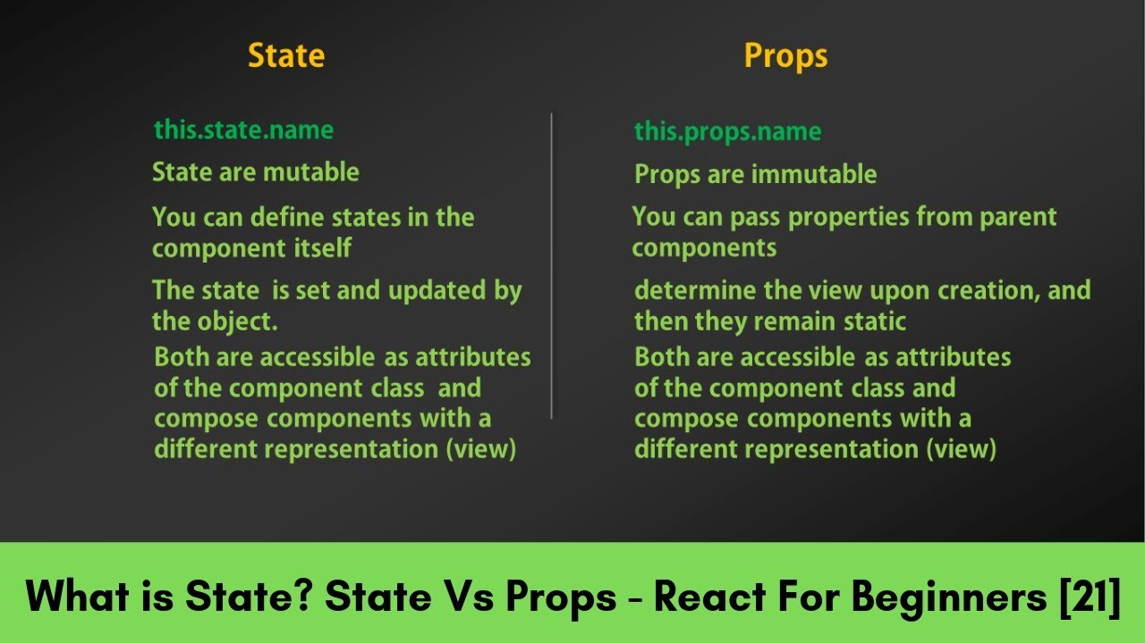
State and Props
State is an updatable object that can be used to hold the data and to control the behavior of the Component. Only Class Components can have State, not the Functional Components. When the State is changed React will automatically re-render the component.

Slide 82
ReactJS | Introduction to Babel
Babel is a very famous transpiler that basically allows us to use future JavaScript in today’s browsers.
In simple words, it can convert the latest version of JavaScript code into the one that the browser understands.
The latest standard version which JavaScript follows is ES2020 which is not fully supported by all the browsers and hence we make use of a tool such as ‘babel’ so that we can convert it into the code that today’s browser understands.

Slide 83
What is transpiler?
It is a tool that is used to convert source code into another source code that is of the same level.
That is why it is also known as a source-to-source compiler. Both the codes are equivalent in nature, considering the fact that one works with the specific version of the br
Note: It is also good to note that a compiler is totally different from a transpiler as the transpiler converts source code into another source code at the same abstraction level, whereas the compiler converts code into a lower level code generally.
Like in Java, the source code is converted to byte Code which is lower level and not equivalent.owser and one doesn’t.

Slide 84
Why do we need Babel?
The main reason we need babel is that it gives us the privilege to make use of the latest things JavaScript has to offer without worrying about whether it will work in the browser or not.
// sample new version javascript code
const fun = (x) => {x*2};
const a = () => {};
const b = (x) => x;
[1, 2, 3].map((n)=> n+1);
// after transpiling
"use strict";
var fun = function fun(x) {
x * 2;
};
var a = function a() {};
var b = function b(x) {
return x;
};
[1, 2, 3].map(function (n) {
return n + 1;
});

Slide 85
ReactJS | Using Babel
Requirements :
A code editor like atom, sublime text or Visual studio code.
Node should be installed on the machine with npm too.
We will install Babel using Node. Open your text editor, then create your directories structure like the one below:
|--node_modules
|--src --app.js
|--.babelrc
|--package.json
|--package.lock.json

Slide 86
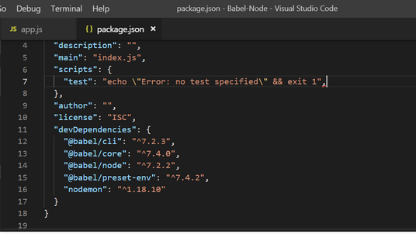
Cont…
Now, open the command line and set the path to the directory of the folder then write these lines in the cmd:
npm install --save-dev @babel/core @babel/cli @babel/preset-env @babel/node
npm install nodemon --save-dev

Slide 87
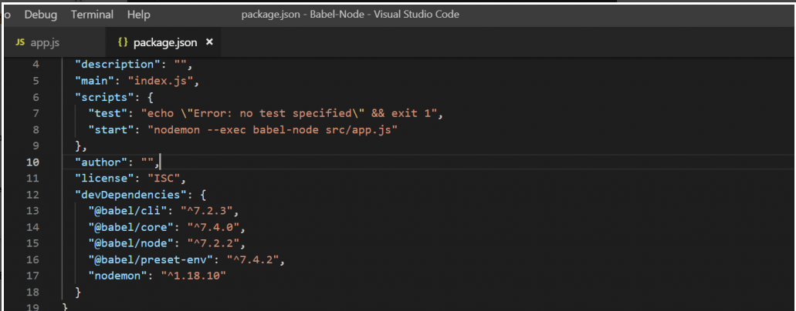
Cont…
babelrc file which we have in our project directory.
// .babelrc { "presets": ["@babel/preset-env"] }
Now we finally need to add scripts into our ‘package.json’ file.
"start": "nodemon --exec babel-node src/app.js" // inside your scripts tag
Or
Extensions (Ctrl+shift+X)
Babel javascript

Slide 88
React Map
A map is a data collection type where data is stored in the form of pairs. It contains a unique key.
The value stored in the map must be mapped to the key.
We cannot store a duplicate pair in the map().
It is because of the uniqueness of each stored key.
It is mainly used for fast searching and looking up data.
In React, the ?map? method used to traverse and display a list of similar objects of a component.
A map is not the feature of React.
Instead, it is the standard JavaScript function that could be called on any array.
The map() method creates a new array by calling a provided function on every element in the calling array.

Slide 89
Example 1, Example 2, Example 3
The map() function takes an array of numbers and double their values. We assign the new array returned by map() to the variable doubleValue and log it.
var numbers = [1, 2, 3, 4, 5];
const doubleValue = numbers.map((number)=>{
return (number * 2);
});
console.log(doubleValue);

Slide 90
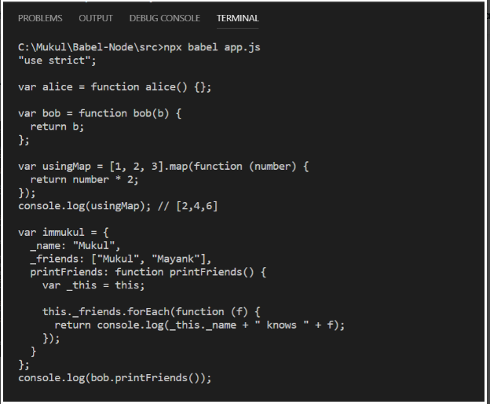
Program code
/ next generation javascript code
let alice = () => {};
let bob = (b) => b;
const usingMap = [1, 2, 3].map((number) => number * 2);
console.log(usingMap); // [2, 4, 6]
var immukul = {
_name: "Mukul",
_friends: ["Mukul", "Mayank"],
printFriends(){
this._friends.forEach(
f =>console.log(this._name + " knows " + f));
}
};
console.log(immukul.printFriends());

Slide 91
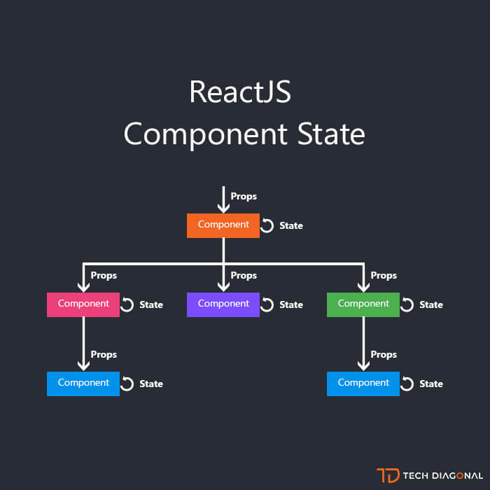
React Component state

Slide 92
React State Management
Managing state is an important part of an application.
Developers usually come to libraries like Redux for a solution. However, people often misuse the library.
For example, they put all state to Redux even the local state like if a sidebar is open or not.
One of the biggest and most common problems in Front end web developer is state management.
What we build: a movie list application in which the user can add a new movie and mark a movie as watched.

Slide 93
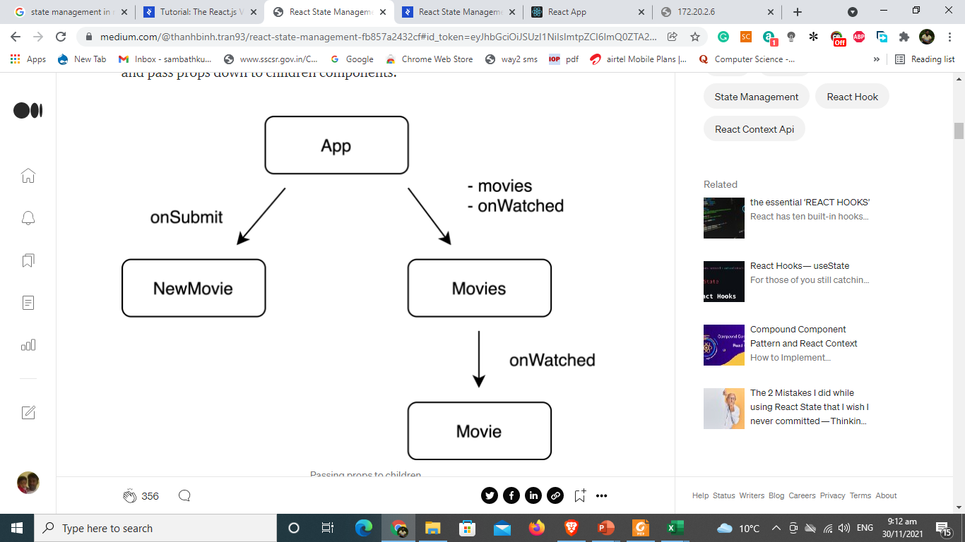
How we would build it before: we handle state in a common parent component and pass props down to children components.

Slide 94
props drilling
Movies and NewMovie components need to access the same state, we lift the state up to the App component which is the central state management.
the Movie component needs a method to modify the state (mark a movie as watched).
The App passes that method as a prop to Movies, and then from Movies to Movie.
Movies component does not use the method onWatched, but still needs to accept it as a prop so that it can pass the prop down to the child Movie.
Imagine there are more components, more children, and more props to pass, the application will become difficult to maintain and develop.

Slide 95
A Bit Of History
web applications had a much simpler data flow.
The browser would send a request to the server, all application logic would be executed on the server, and a full HTML view would be sent back to the browser for presentation to the user.
Subsequent user actions (such as clicks, form submissions, etc.) would trigger the same flow again. Applications did not have to worry about the user state and each view could be regenerated by sending a new request to the server.

Slide 96
Cont
web applications grew in their complexity and user demands of the UI/UX were advancing as well.
Reloading the whole page, when just one part of it changes, was ineffective and slow.
We needed a quick, snappy, and responsive interaction with immediate impact on the UI.

Slide 97
Cont
JavaScript came to the rescue.
Developers started writing significant amounts of code that was executed in the browser before a request was sent to the server.
jQuery also brought significant advances to front-end web development, as it provided simple and effective out-of-the-box capabilities such as client side validation, modal windows, alert messages, animations, and even Ajax-based partial page updates.

Slide 98
Code demonstrates how this could be done by DOM manipulation
var color = (strength == 'weak' ? 'red' : 'green');
setInputBorderColor(color);
var message = (strength == 'weak' ?
"Password is weak" :
"That's what I call a password!");
if (hasMessage()) {
setMessageText(message);
} else {
addMessageWithText(message);
}
if (strength == 'weak') {
if (hasSmiley()) {
removeSmiley();
}
} else {
if (!hasSmiley()) {
addSmiley();
}
}
}
if (hasInputBorder()) {
removeInputBorder();
}
if (text.length === 0) {
if (hasMessage()) {
removeMessage();
}
if (hasSmiley()) {
removeSmiley();
}
}
else {
var strength = getPasswordStrength(text);
if (!hasInputBorder()) {
addInputBorder();
}

Slide 99
Cont
first we need to check if the user provided any password at all and handle the case where the password field is empty.
And in all cases, we need to make sure that all related DOM elements are properly updated.
This includes the message, the border, and the smiley face.
Our password field can be in one of three states: empty, weak, or strong.
we have three different DOM elements that are affected by the password field state. Handling all combinations, and making sure that our view is properly displayed, increases cyclomatic complexity for even a simple piece of code like this.

Slide 100
Cont
we defined three view states, which gave us 3 * 2 = 6 transitions.
In general, given N states, we have N * (N - 1) = N^2 - N transitions that we would need to model.
Just think about the increased complexity if we added a fourth state to our example.

Slide 101
Reducing Complexity
Assuming that we could declare the view state based on the model state, instead of explicitly coding the transition from one state to another.
var strength = getPasswordStrength(text);
if (text.length == 0) {
return div(input({type: 'password', value: text}));
} else if (strength == 'weak') {
return div(
input({type: 'password', value: text, borderColor: 'red'}),
span({}, "Weak")
);
} else {
return div(
input({type: 'password', value: text, borderColor: 'green'}),
span({}, "That's what I call a password!"),
img({class: 'icon-smiley'})
);
}

Slide 102
React based UI.
} else if (strength == 'weak') {
return <div>
<input type="password" value={this.state.value} onChange={this.handleInputChange} style={ {border: '1px solid red'} } />
<span style={{color: 'red'}}>Weak!</span>
</div>;
} else {
return <div>
<input type="password" value={this.state.value} onChange={this.handleInputChange} style={ {border: '1px solid green'} } />
<span style={{color: 'green'}}>That's what I call a password!</span>
<Emoji value="smiley" />
</div>;
}
},
handleInputChange: function(ev) {
this.setState({value: ev.target.value});
}
});
React.render(<PasswordWithStrength />, document.body);
function getPasswordStrength(text) {
// Some code that calculates the strength given the password text.
}
var PasswordWithStrength = React.createClass({
getInitialState: function() {
return {value: ''};
},
render: function() {
var strength = getPasswordStrength(this.state.value);
if (this.state.value.length == 0) {
return <div>
<input type="password" value={this.state.value} onChange={this.handleInputChange} />
</div>;

Slide 103
Emoji component
Emoji component that is rendered when the password strength is OK with
var Emoji = React.createClass({
render: function() {
var emojiSrc = this.props.value + '.png';
return <img src={emojiSrc}></img>;
}
});

